Slide 1
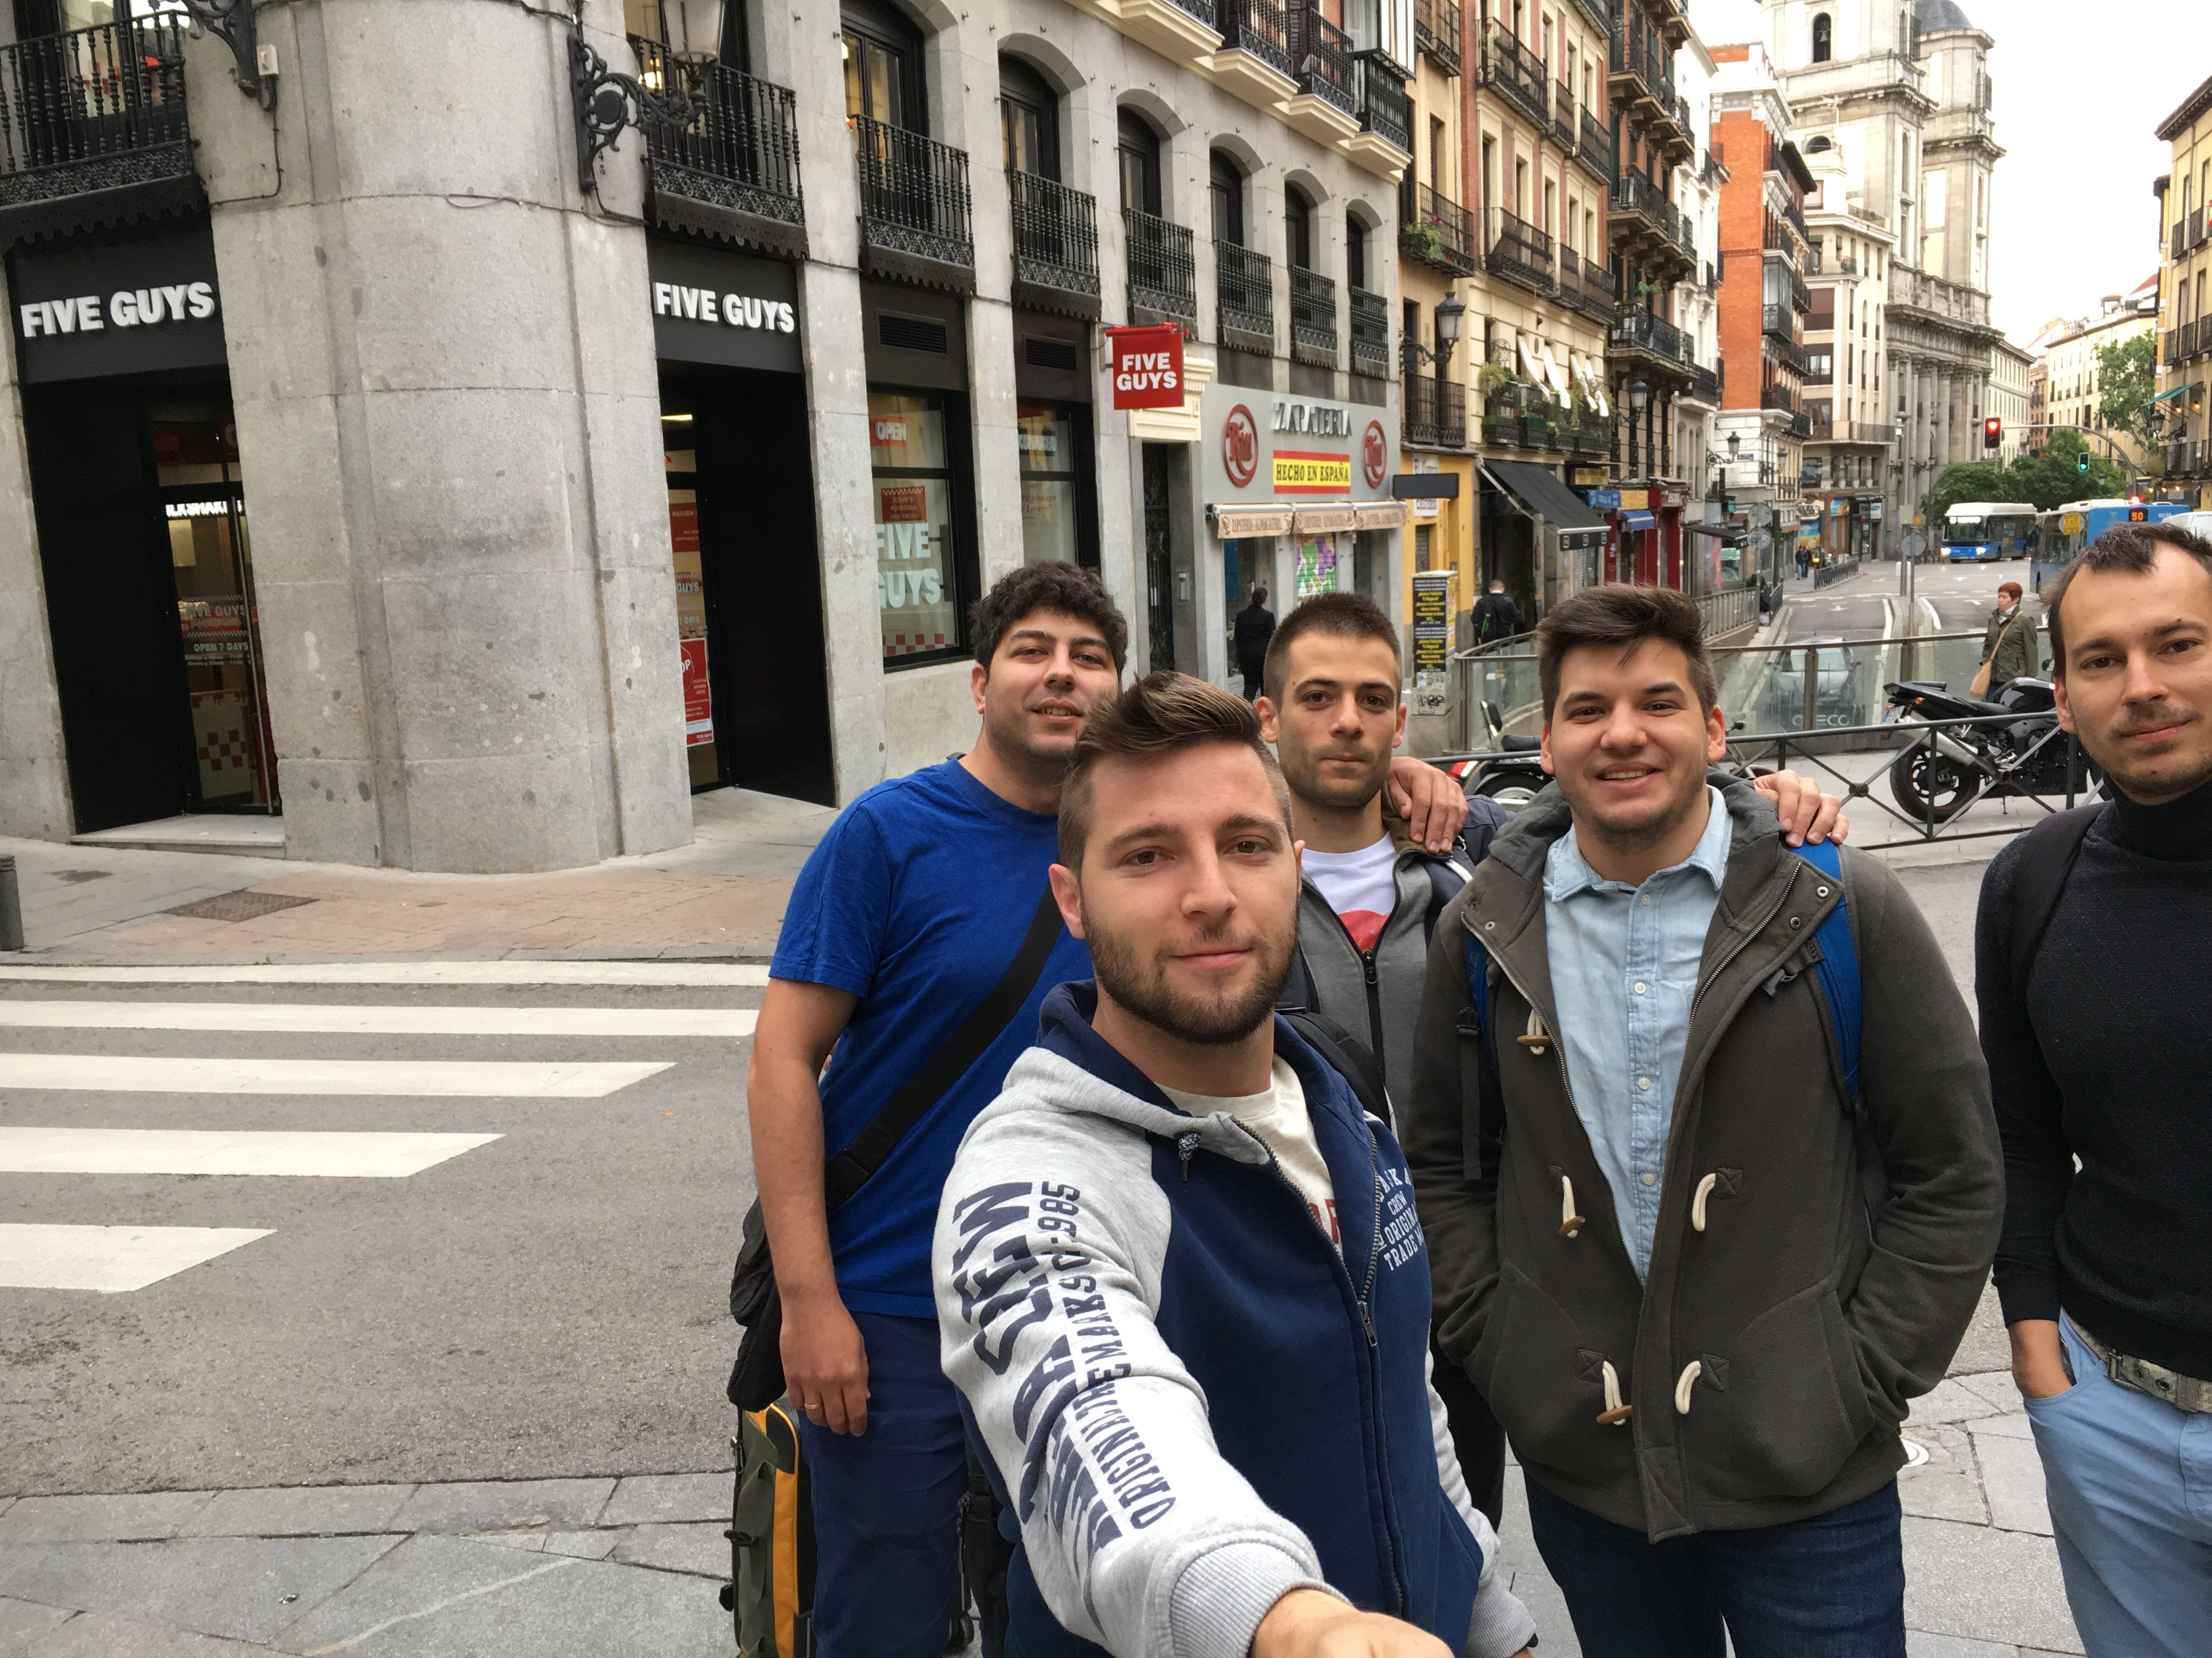




“all in”
TEAM PICTURE
Deyan Makedonsky
Dimitar Kostov
Nikolay Gospodinov
Plamen Terziev
Svetoslav Popov
“Enable sports through technology”
Machine Learning
iOS
Social Networking
TECHNOLOGIES
Big Data
React Native
Image Recognition
IoT
WatchOS
None

